Slide 1
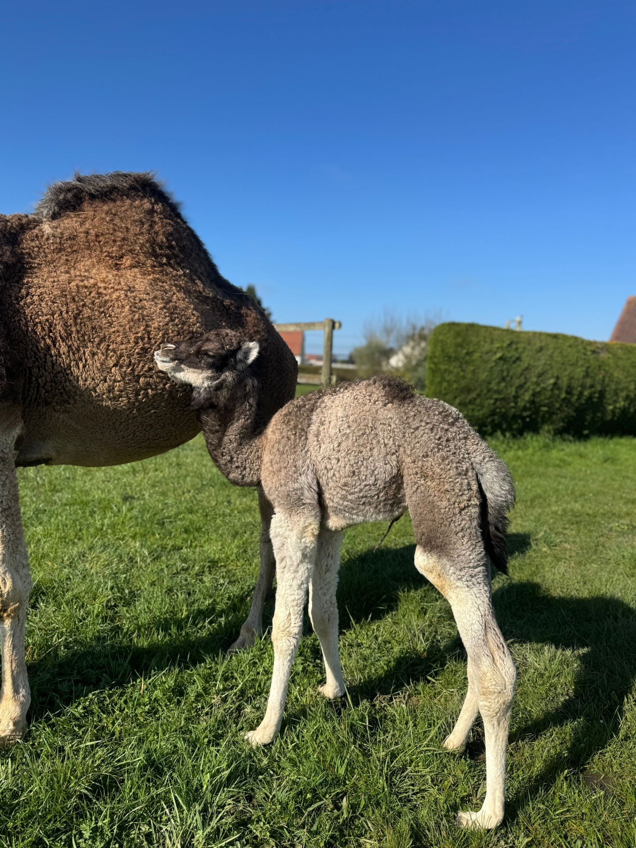



ECROA-Webinar
The Camelait4Med research project:
Significance for European camel keepers
A unique opportunity to explore the future of sustainable camel milk production and animal welfare.
📅 Date
Monday, May 25, 2026
9:00 PM -10:00 PM
💻 Online meeting
🌐 Info
www.ECROA.org
contact@ECROA.org

Slide 2
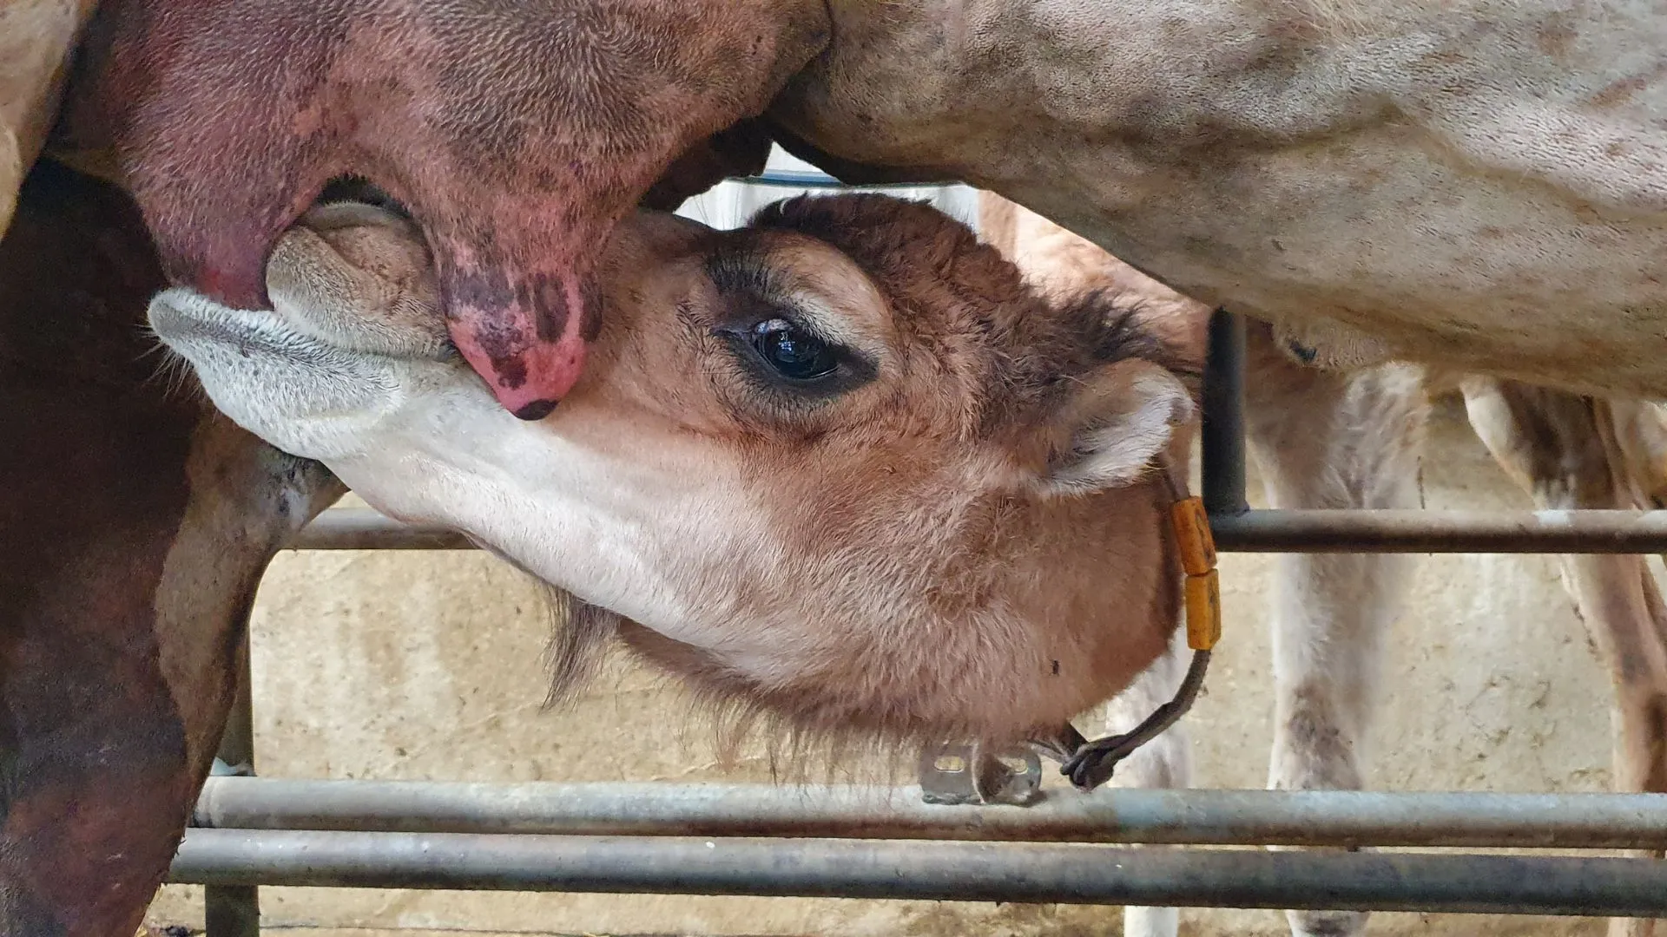

About the Event
A Must-Attend Gathering
This webinar brings together European camel farming professionals to share practical knowledge on milking, health, and the management of large camelids. program.
Organized in partnership with the CAMELAIT4MED project, co-funded by the European Union through the PRIMA .

Slide 3
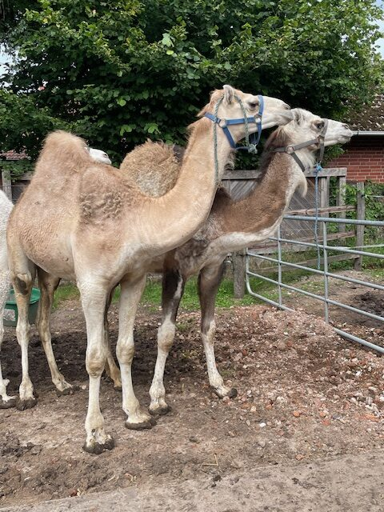
Program
The CAMELAIT4MED offers European camel farmers new opportunities for sustainable milk production, with a focus on technology, animal welfare and market access. Small producers in particular can benefit from better milking techniques, circular feeding strategies and innovative packaging.
During this webinar, Professor pierre-Guy Marnet will clarify what this can mean for European camel farmers.
.

Slide 4



ECROA Camel-related webinars
The European Camel Ranch Owners Association (ECROA) organizes annually several webinars on topics of interest to camel keepers and camel enthusiasts, including scientific researchers, camel-related companies and government agencies. The focus is on animal welfare, sustainability, innovation and effective regulations
INTERACTION
Participants can ask questions prior to each webinar, which will be answered during the webinar. Of course, questions can also be asked during the webinars.
Registration Fee
Participation is free for this first ECROA webinar .
ECROA members receive a discount when participating in the upcoming webinars.

Slide 5

Registration and interaction
— Registration
— Send an email to
contact@ecroa.org specifying
your e-mail address . You will then receive the link to the webinar.
— Interaction
— Send an email with your
questions to contact@ecroa.org

Slide 6


Partners & Supporters
ECROA
European Camel ranch Owners Association -The reference organization for owners and researchers working on camelids in Europe.
CAMELAIT4MED
A European project aimed at structuring and developing the camel milk sector in the Mediterranean and across Europe, with the support of the PRIMA program.

Slide 7
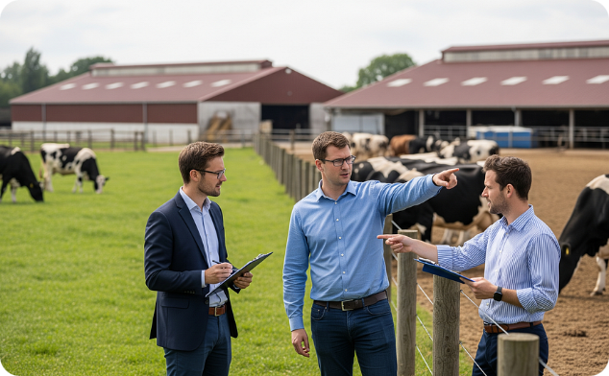


Why Attend?
Field Expertise
A Future-Proof Sector
European Network
Gain direct insights from farmers and researchers specialized in large camelids.
Camel milk production in Europe is booming. Position yourself at the forefront of this innovative sector.
Meet and connect with professionals from across Europe who share the same passion for camelids.

Slide 8

Join Us on May 25, 2026
A unique opportunity to explore the future of sustainable camel milk production and animal welfare — practical insights for European camel farming professionals.
📧 Contact
🌐 Web
contact@ECROA.org
www.ECROA.org
Before may 20, 2026

