Slide 1
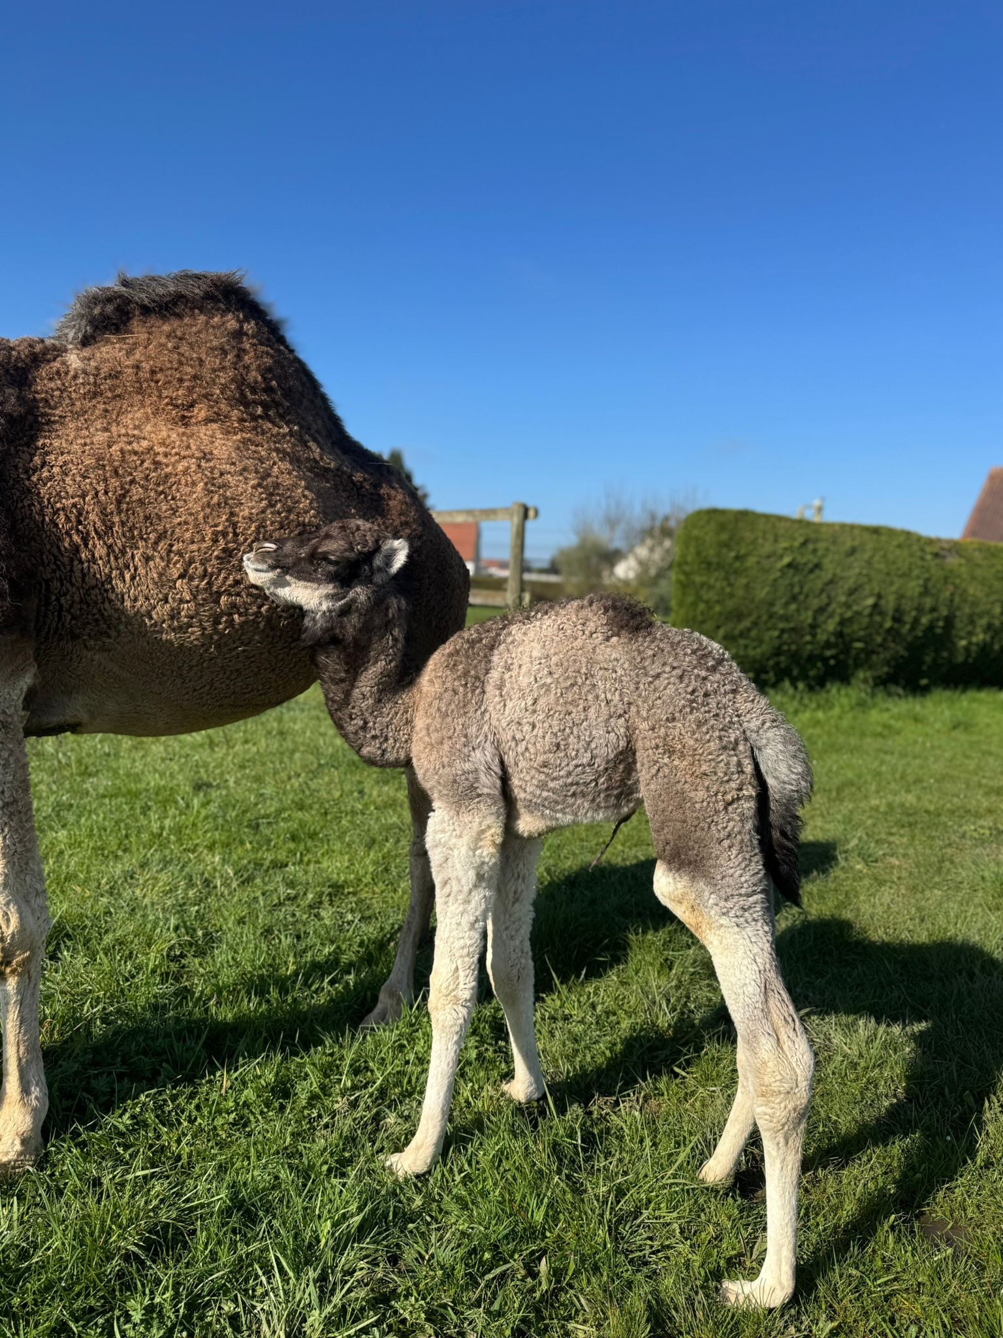




ECROA – Technical Day
Dairy Production and Health of Large Camelids
Mini-Symposium at the Largest Dromedary Farm in Europe — A unique opportunity to explore the future of sustainable camel milk production and animal welfare.
📅 Date
📍 Location
Sunday, June 7, 2026
10:00 AM – 3:00 PM
Cameldairy Smits
Berlicum, Pays-Bas
🌐 Info
ECROA.org
contact@ECROA.org

Slide 2
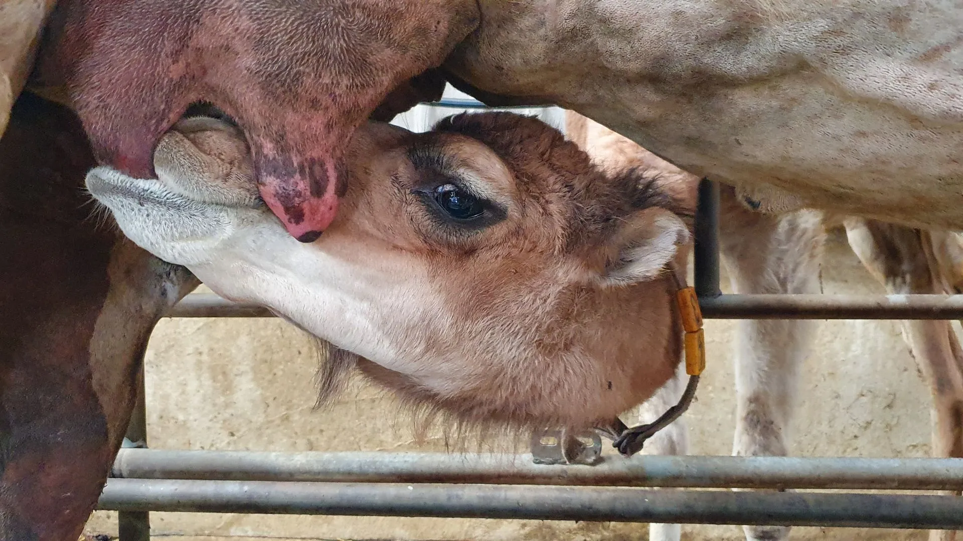

About the Event
A Must-Attend Gathering
This Technical Day brings together European camel farming professionals to share practical knowledge on milking, health, and the management of large camelids. program.
Organized in partnership with the CAMELAIT4MED project, co-funded by the European Union through the PRIMA .

Slide 3
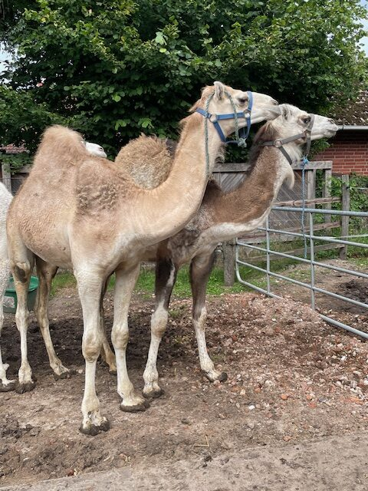

Day Programme
A structured day combining field visits, expert conferences, and institutional discussions.

Slide 4
Day Schedule
10:00 AM – 10:45 AM
1
Field tour of the farm— Marcel Smits opens the doors of Cameldairy, the largest camel farm in Europe.
2
10:45 AM – 11:00 AM
European Farmers' Challenges — Feedback from Marcel Smits on the current issues facing the sector in Europe
11:00 AM – 12:00 AM
3
Milking Procedures — Lecture by Full Professor Pierre-Guy Marnet on best practices for milking in European camelids.
00:00 PM – 00:20 PM
4
Camel reproductive disorders and related practical experience. Dr. Salman Khan,
00: 20 PM – 00:35 PM
5
Milking camels in North Afrika: What can European camel milkers learn? Nassima Ouchkeni
00:35 PM – 00:45 PM
6
ECROA and Large Camelids — Missions and projects of ECROA . Olivier Philipponneau
Lunch Break— Dutch meal included for in-person participants.
7
2:00 PM – 3:00 PM
ECROA General Assembly & Discussion on the Camelait4MED project

Slide 5



Registration Fees
In-Person
💻 Online meeting
Drink and lunch including
ECROA Members
free
ECROA Members
40 €
No-members
30 €
No-members
60 €
🎁 Online (Video Conference)
Bonus Webinar on May 25 at 9:00 PM "Importance for European Camel Farmers"
www.ecroa.org
Discovery Pack — Membership (€55) + Symposium (€40)
90 €
Limited to 20 in-person participants. Registration deadline: June 1, 2026

Slide 6


How to Register
— Registration Steps
1
— Send an email
Write to contact@ecroa.org specifying: in-person or online, membership status, and dietary requirements.
2
Make the payment
*Before June 4, 2026 — Reference: "Technical Day
Bank details : IBAN : NL34 ABNA 0537611681 BIC : ABNANL2A
Bénéficiairy : Kington Innovatief BV. State: “Technical day ECROA 2026”

Slide 7
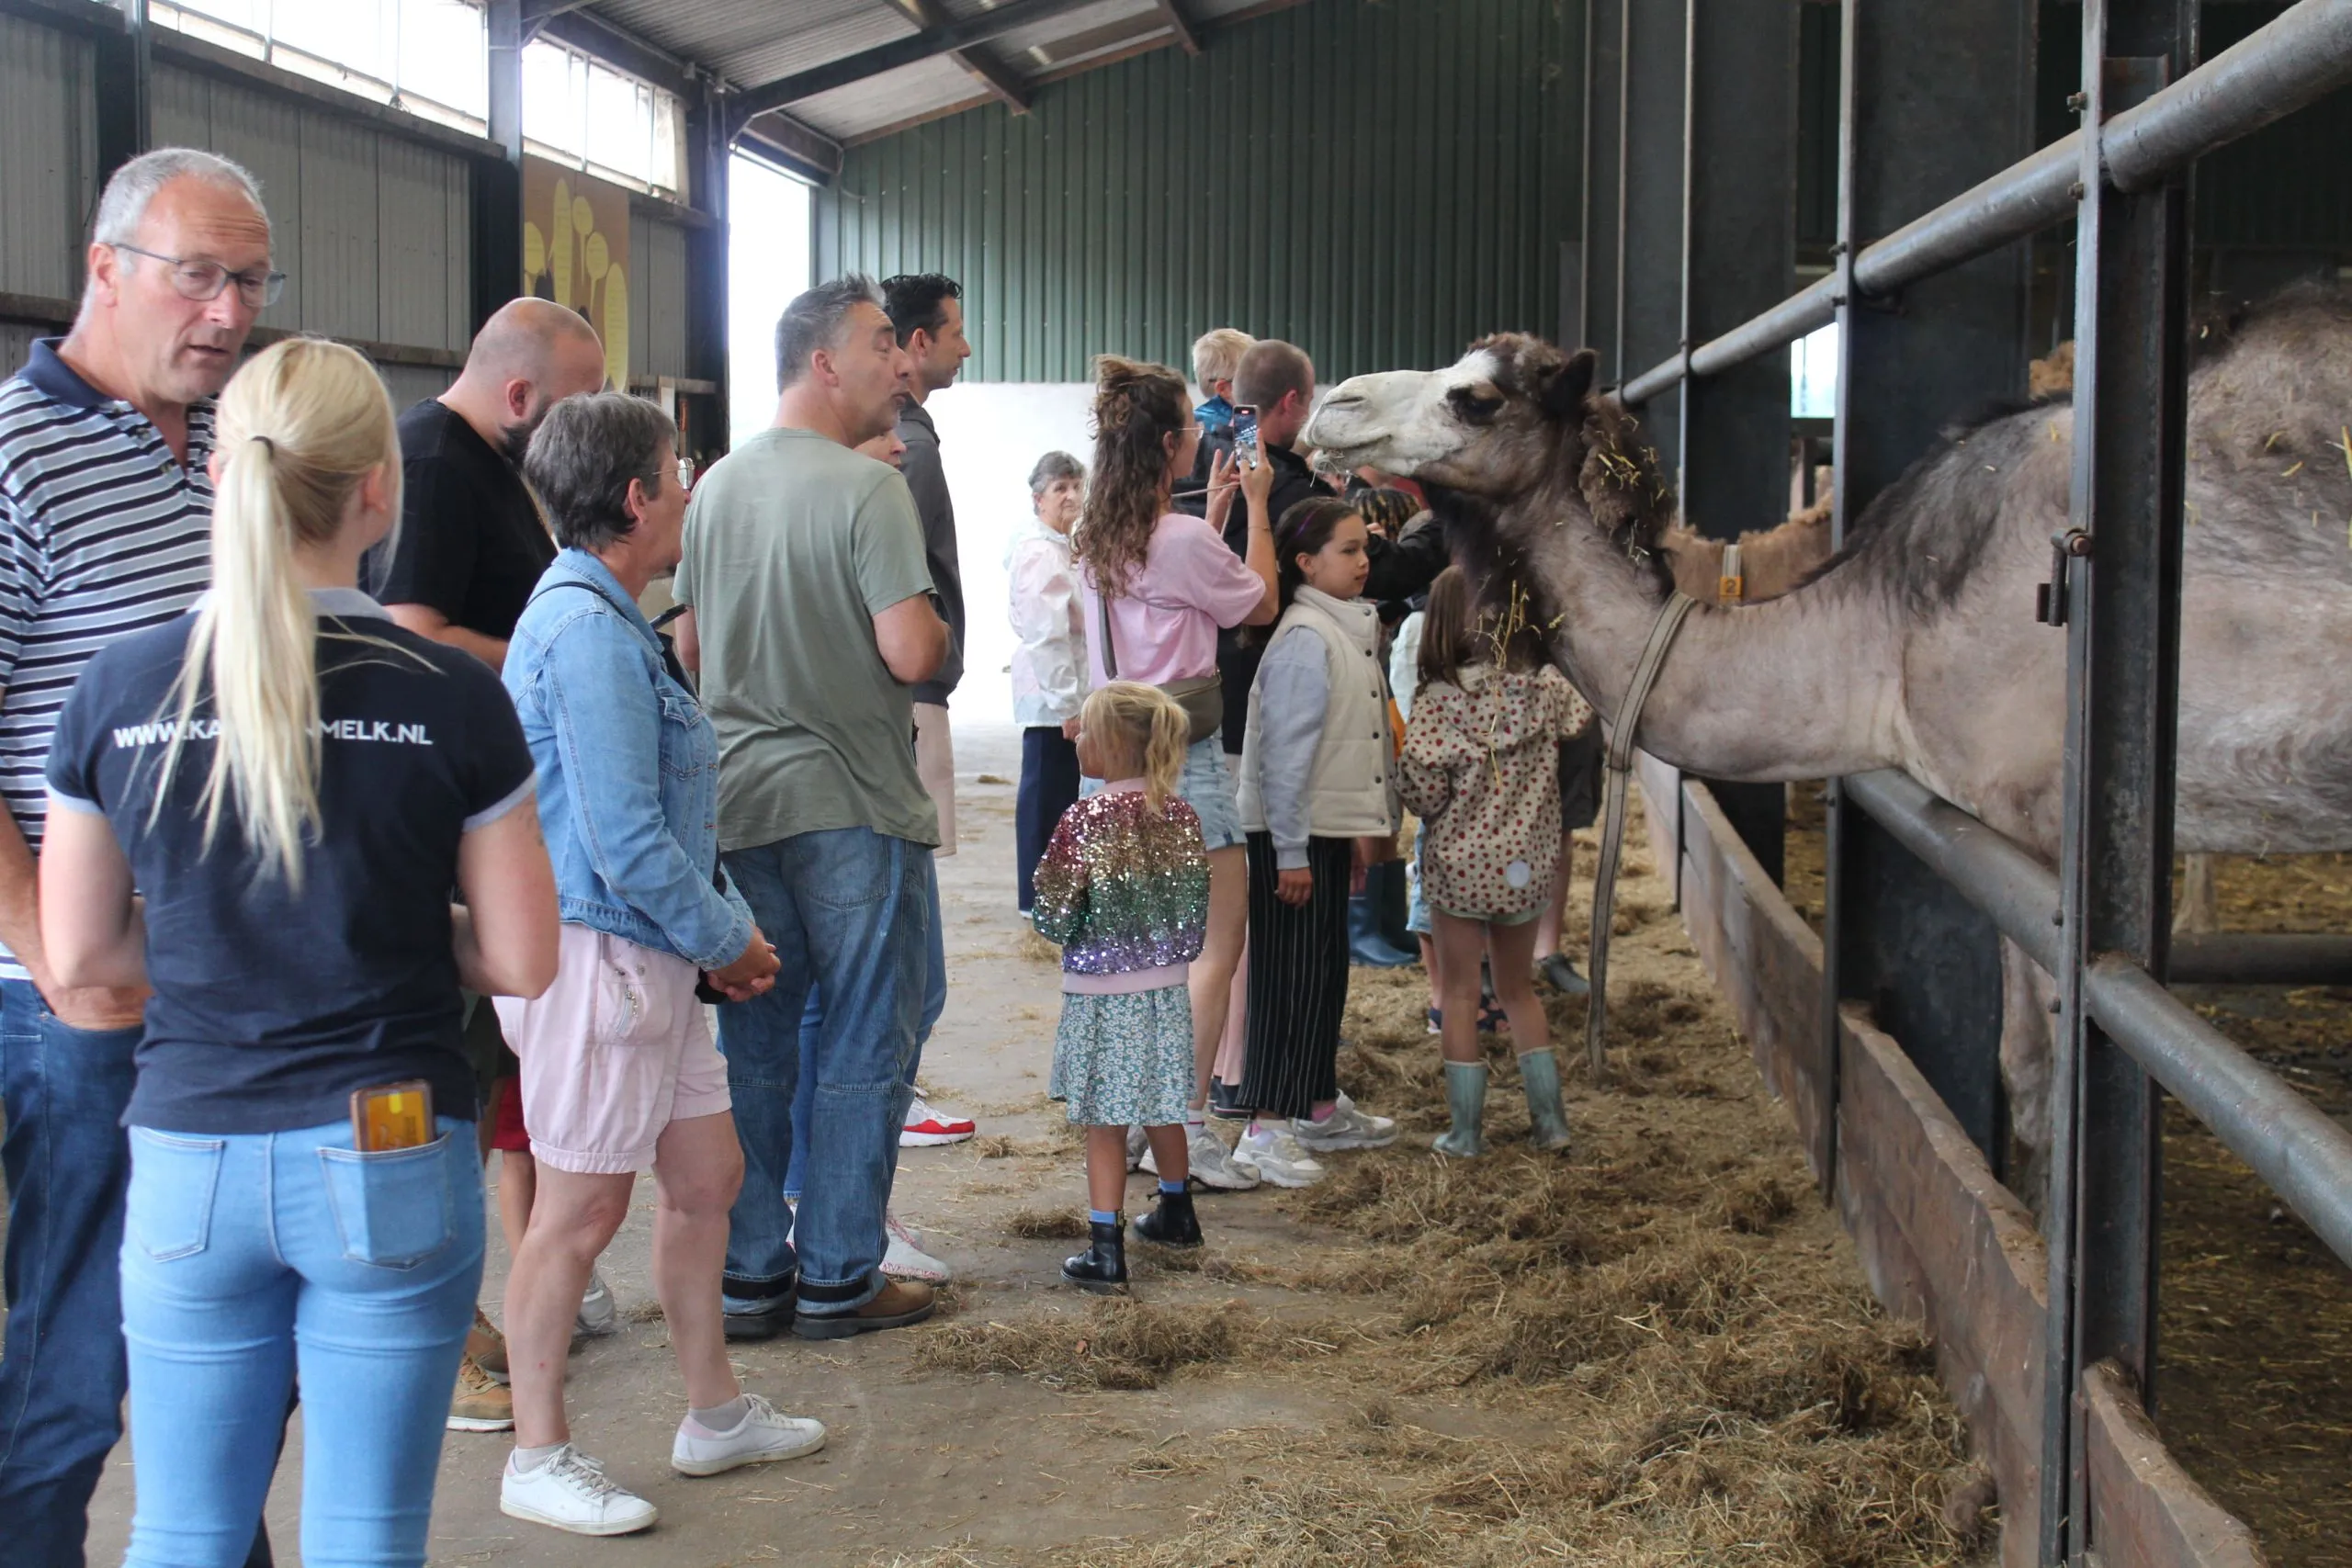
The venue : Cameldairy Smits
Werstkant 16, 5258 TC Berlicum, the netherlands
Largest camel farm in Europe
Sustainable milk
An approach focused on animal welfare and respectful breeding practices.
A pioneering farm in the industrial-scale production of camel milk.
🌍 European Model
An inspiring example for professionals looking to develop the camel farming sector in Europe.

Slide 8

Partners & Supporters
ECROA
European Camel ranch Owners Association -The reference organization for owners and researchers working on camelids in Europe
Camel dairy Smits
The first and largest camel dairy in Europe.
A European project aimed at structuring and developing the camel milk sector in the Mediterranean and across Europe, with the support of the PRIMA program.
CAMELAIT4MED

Slide 9
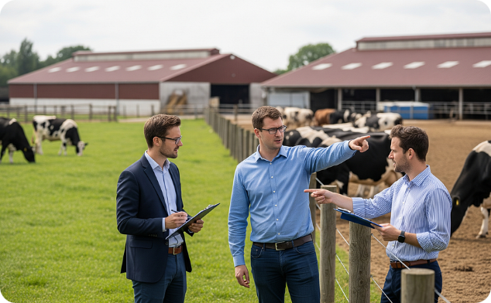


Why Attend?
Field Expertise
A Future-Proof Sector
European Network
Gain direct insights from farmers and researchers specialized in large camelids.
Camel milk production in Europe is booming. Position yourself at the forefront of this innovative sector.
Meet and connect with professionals from across Europe who share the same passion for camelids.

Slide 10

Join Us on June 7, 2026
A unique opportunity to explore the future of sustainable camel milk production and animal welfare — practical insights for European camel farming professionals.
📧 Contact
🌐 Web
contact@ECROA.org
www.ECROA.org
Before June 4, 2026

